Slide 1
FOUNDATIONS OF AI LAB
NAME-
ANAYA-20BCS5125
ANMOL-20BCS5127
HARSH-20BCS5155
MUKUL-20BCS5156
VAIBHAV-20BCS5186

Slide 2
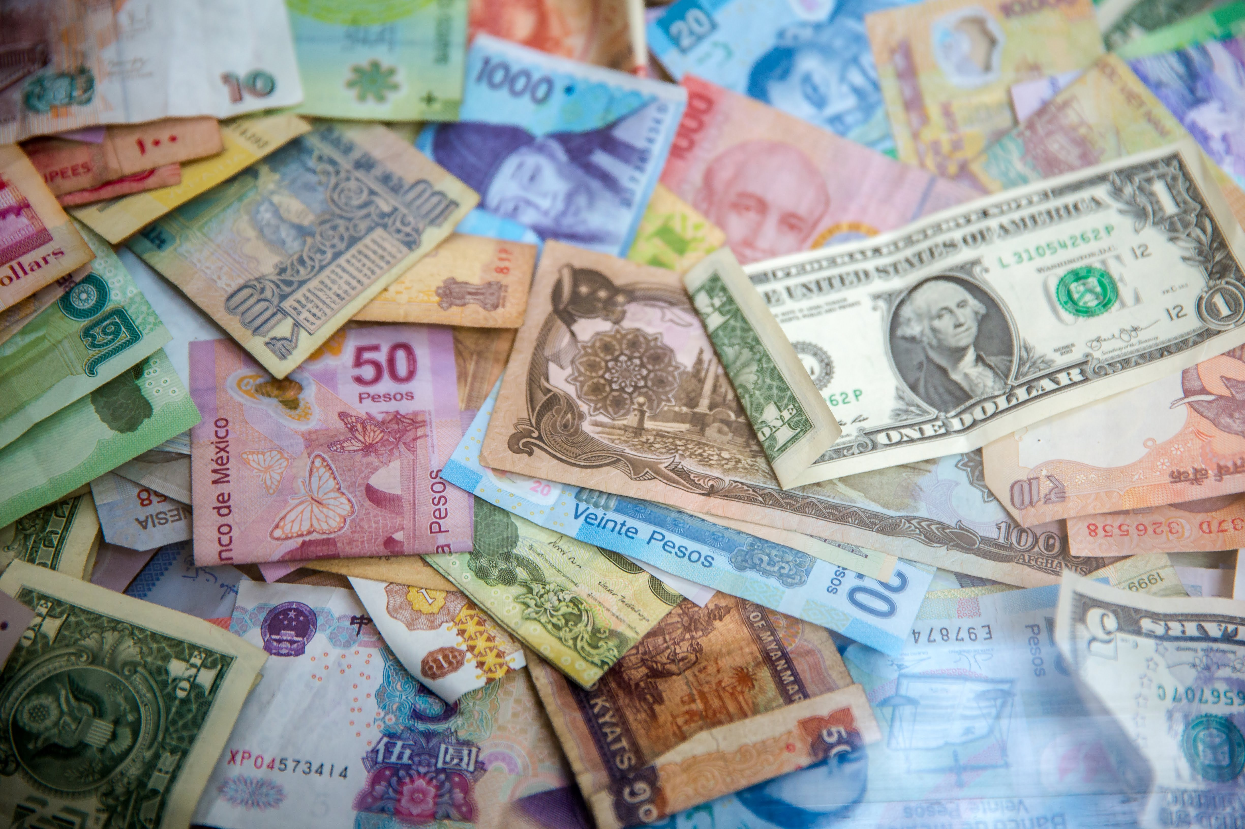
PROJECT- CURRENCY CONVERTOR USING PYTHON

Slide 3
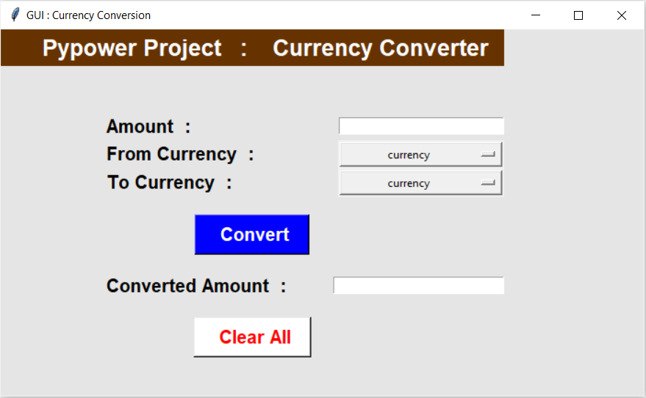
PRESENTATION IN BRIEF
1.This whole CONVERTER works purely on the basis of tkinter, which is basically the python toolkit for Graphical user interface(GUI).
2.Also the modules used is forex_python.
3.Now, the basic function of this GUI is to convert the given currency of any particular country to the country that we want.

Slide 4
CODES:

Slide 5
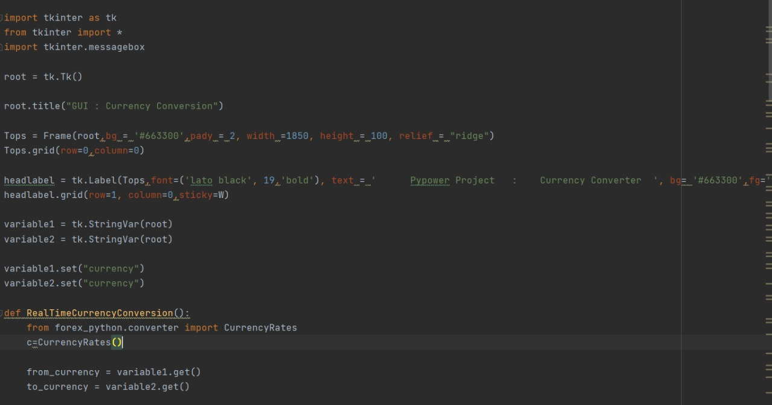

Slide 6
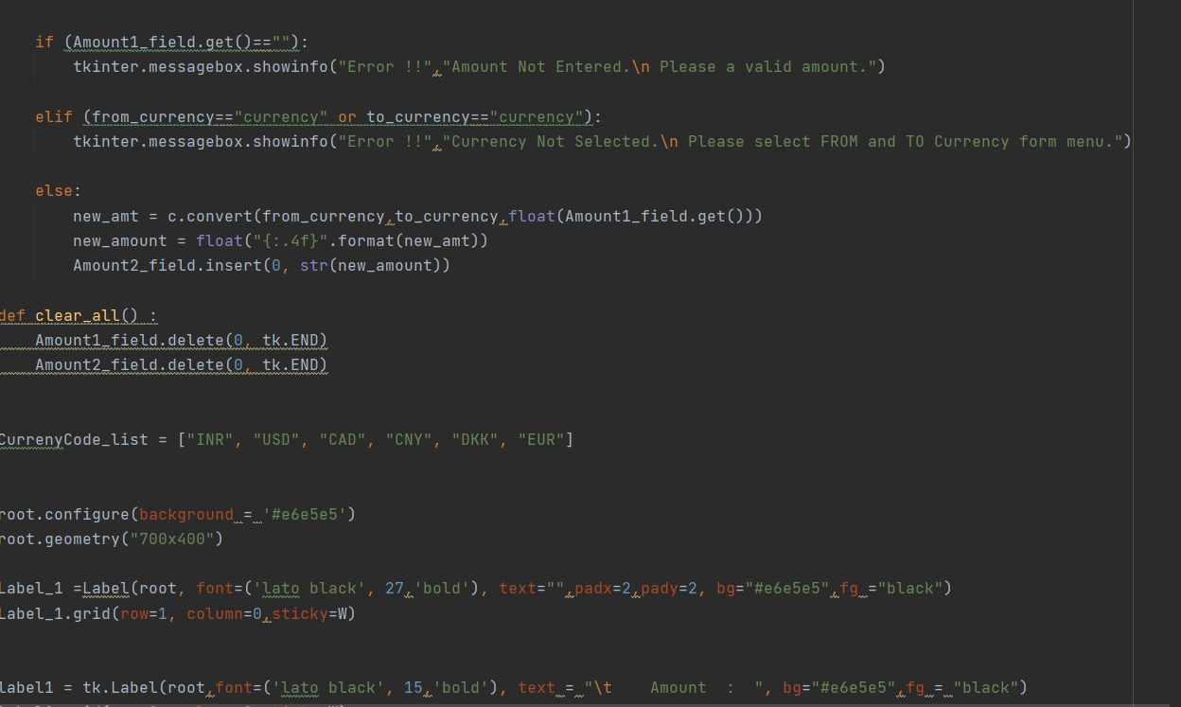

Slide 7
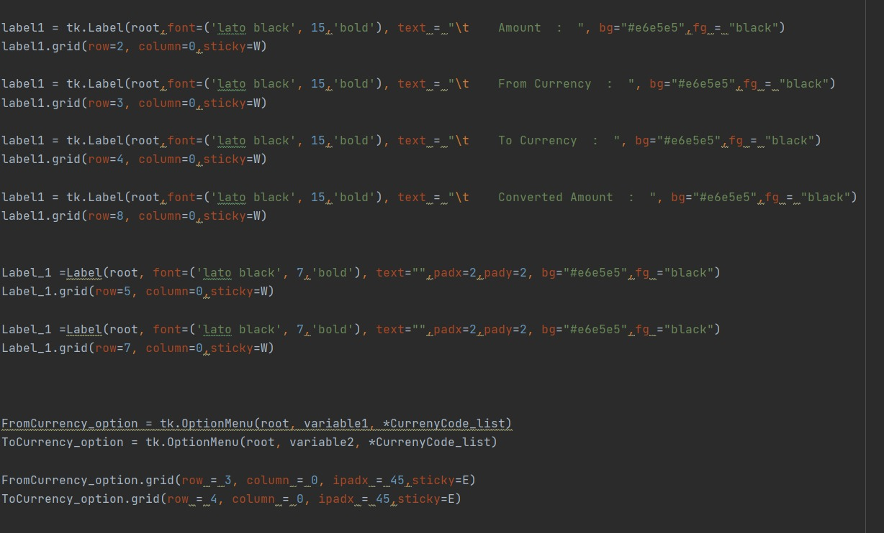

Slide 8
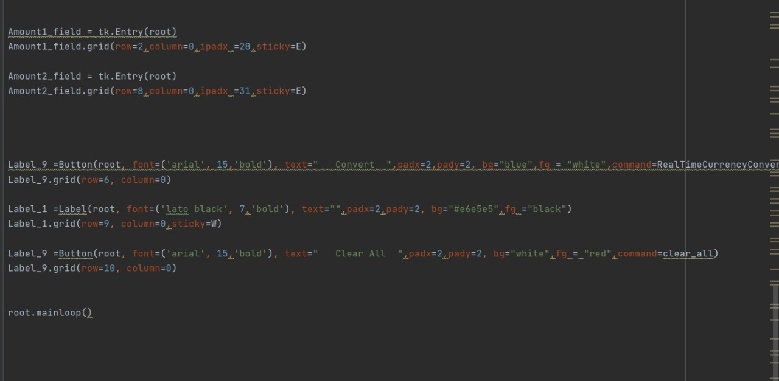

Slide 9
MODULES USED:
1.forex_python
2.Tkinter

Slide 10
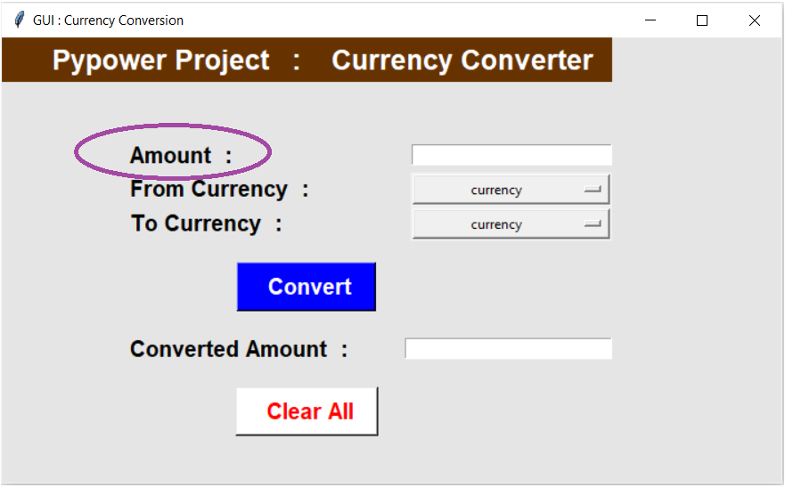
Enter the amount to convert from one currency to another.☺

Slide 11
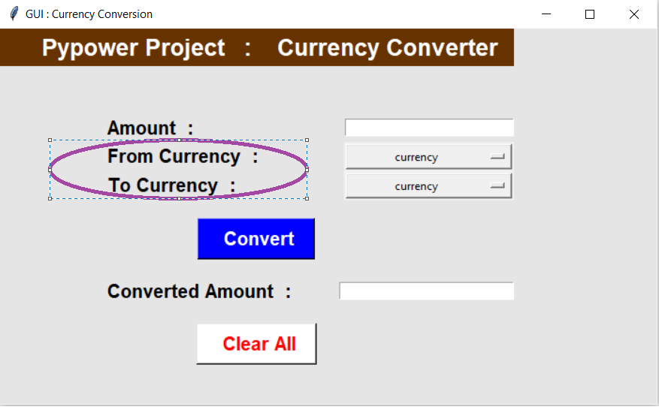
Selection of currency which u want to convert and into which currency.☺

Slide 12
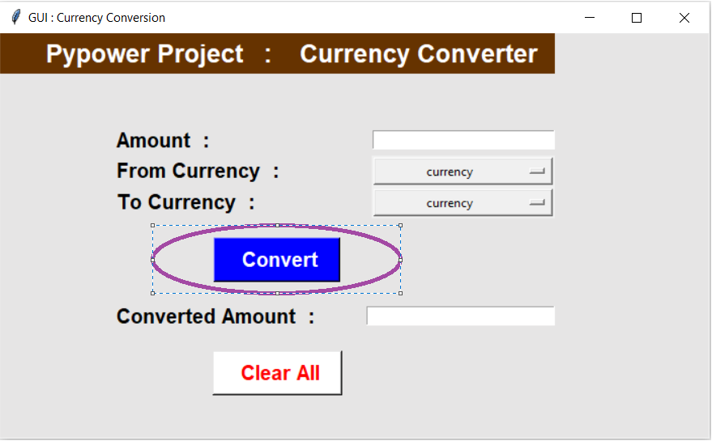
Click on the convert button.☺

Slide 13
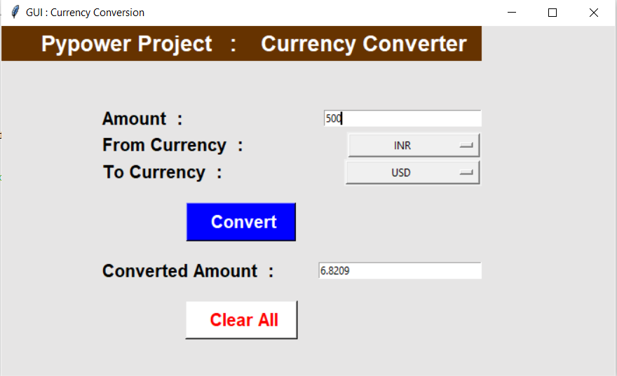
Result☺☺

Slide 14
ADVANTAGES:
1.OFFLINE CONVERTER
2.SUPPORTS SIX CURRENCY TYPES
3.USES GUI(GRAPHICAL USER INTERFACE)
4.EASY TO USE
5.FREE OF COST

Slide 15
DISADVANTAGES:
1.NEEDS PYTHON CODE TO RUN
2.CANNOT RUN ON ALL PLATFORMS EX-PHONES,TABLET ETC.
3.CURRENCY VALUE CHANGES RAPIDLY AND IT CONTAINS ONLY ONE VALUE FOR CURRENCY CONVERSION.

Slide 16
IMPLEMENTATION OF THE PROJECT:

Slide 17
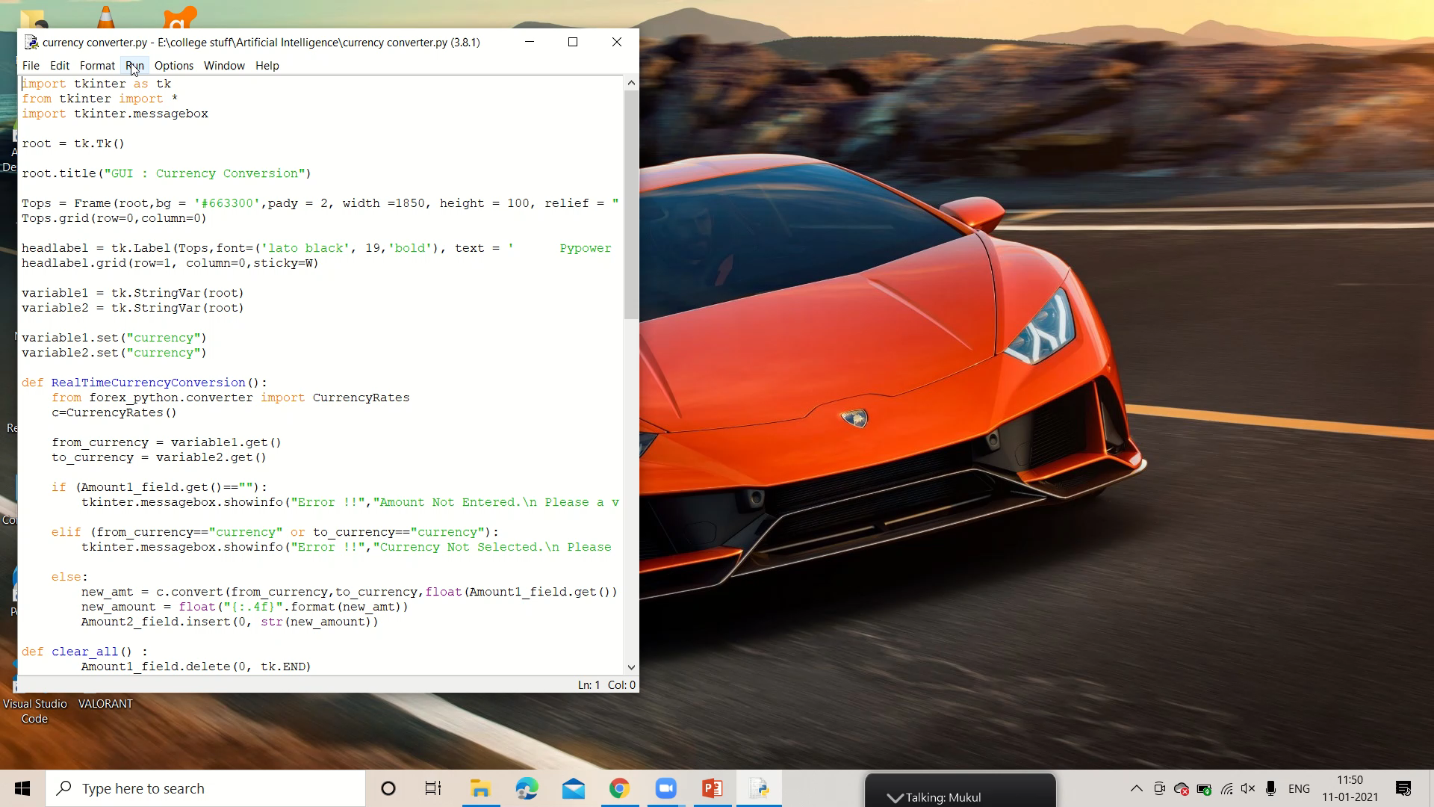

Slide 18
THANK YOU☺

